Slide 1
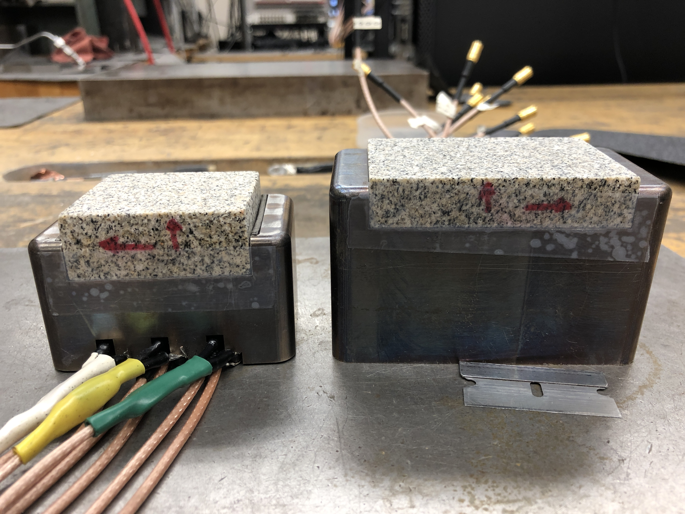
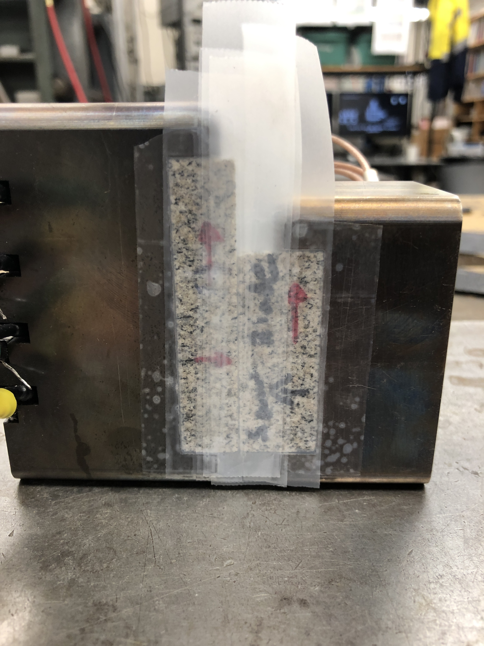
p5704 – 120/80 grit, perm test

Slide 2
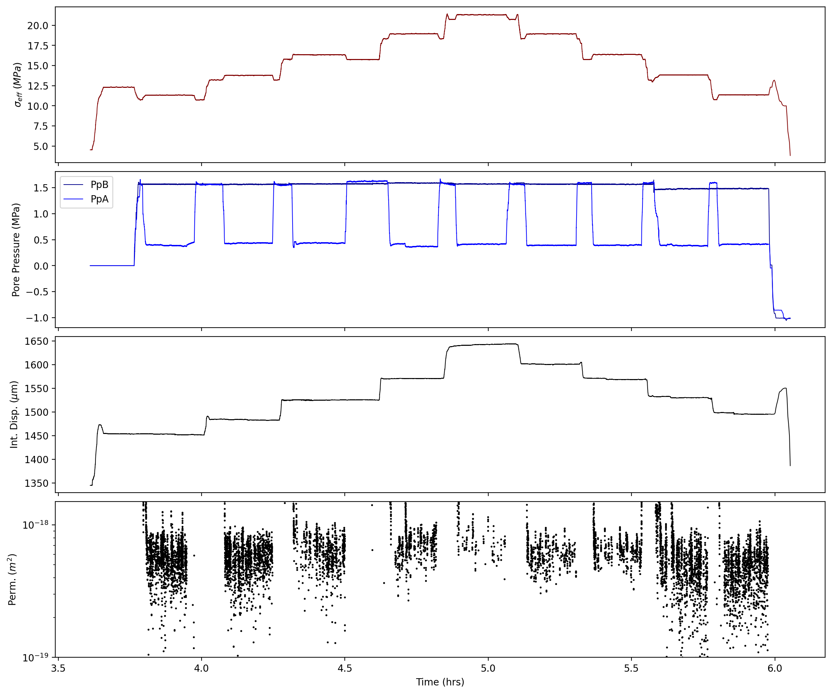
p5704

Slide 3
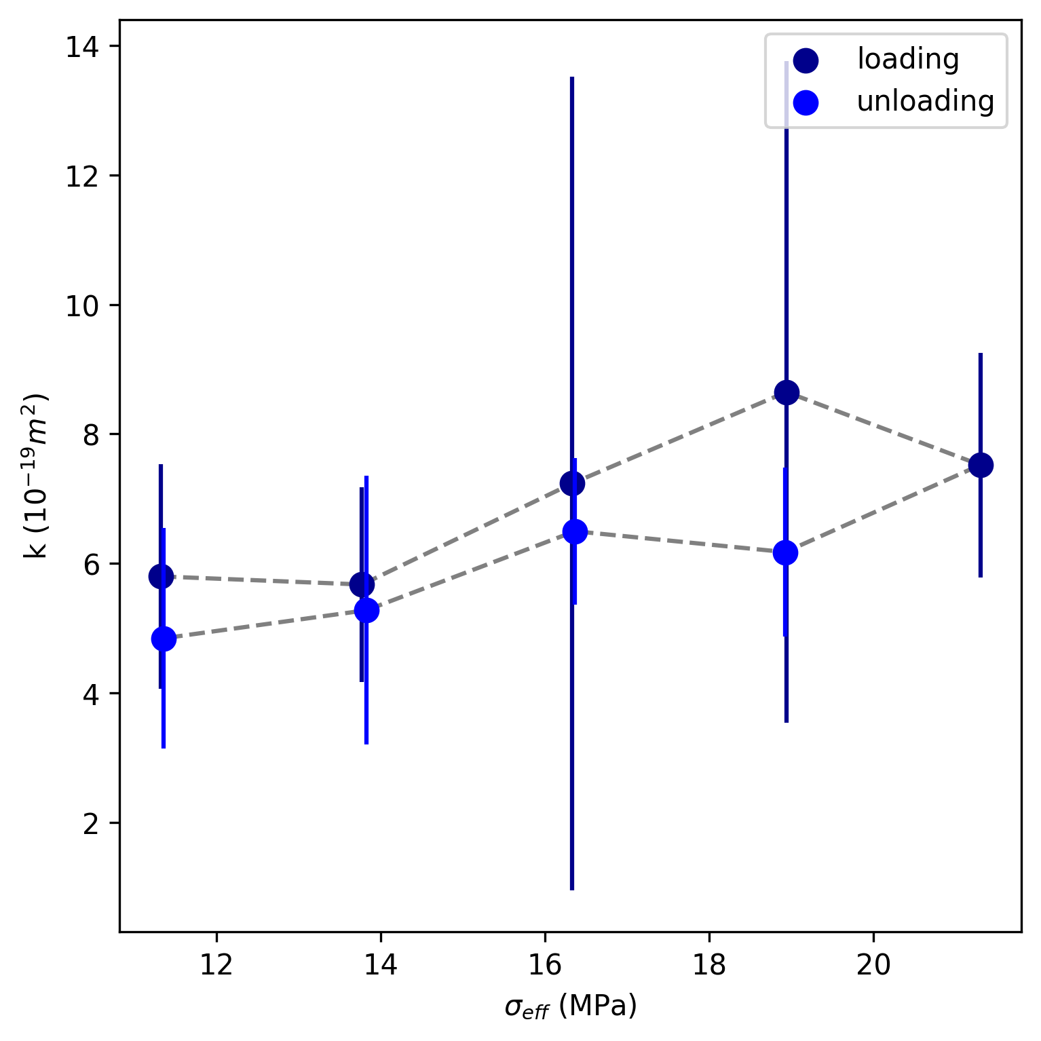
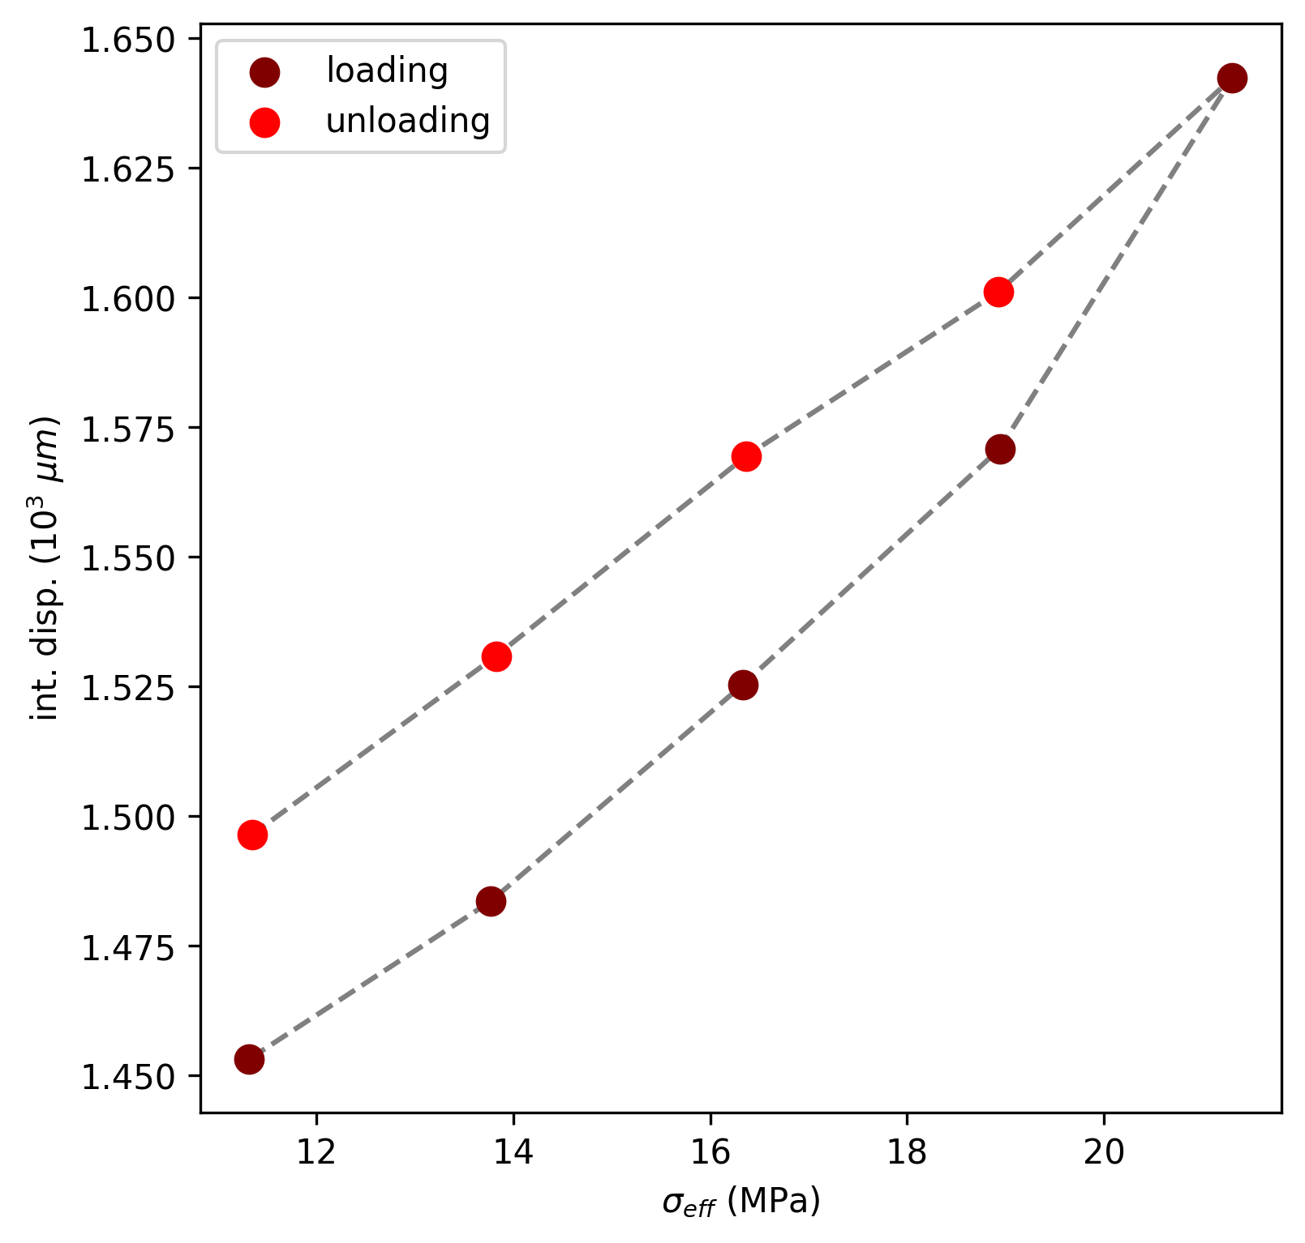

Slide 4
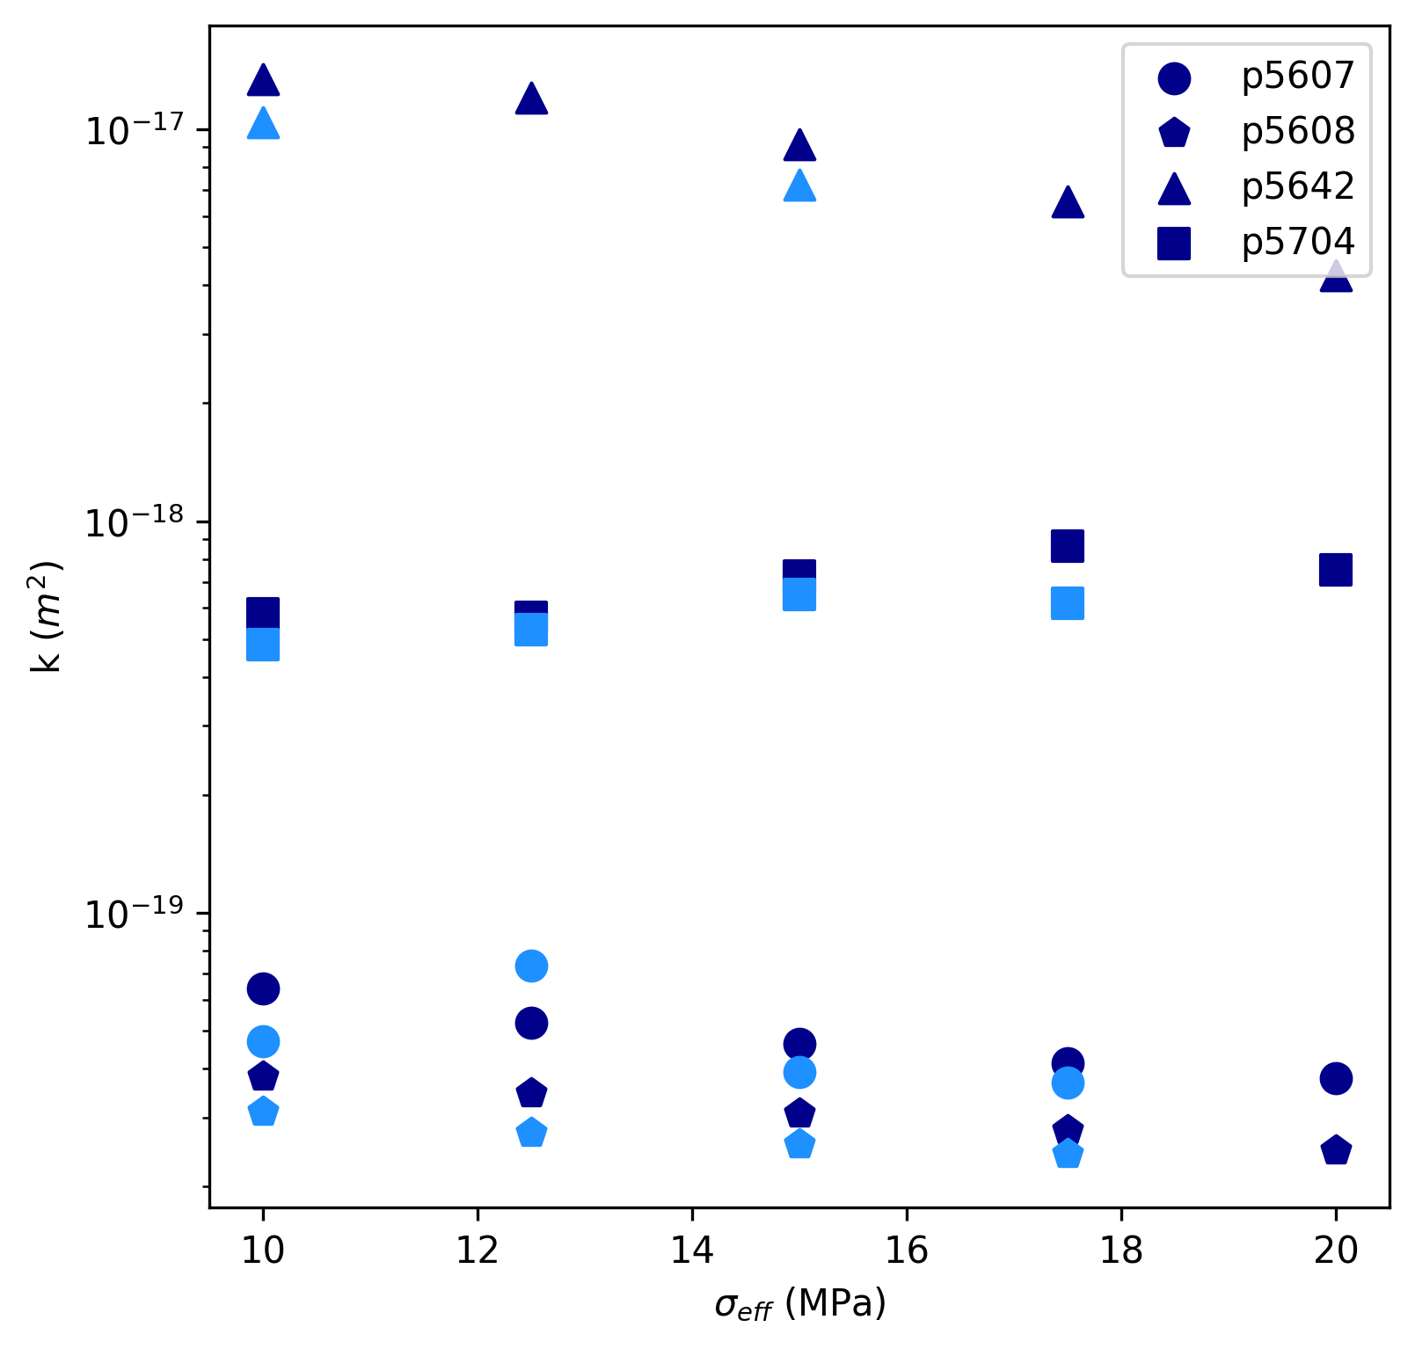
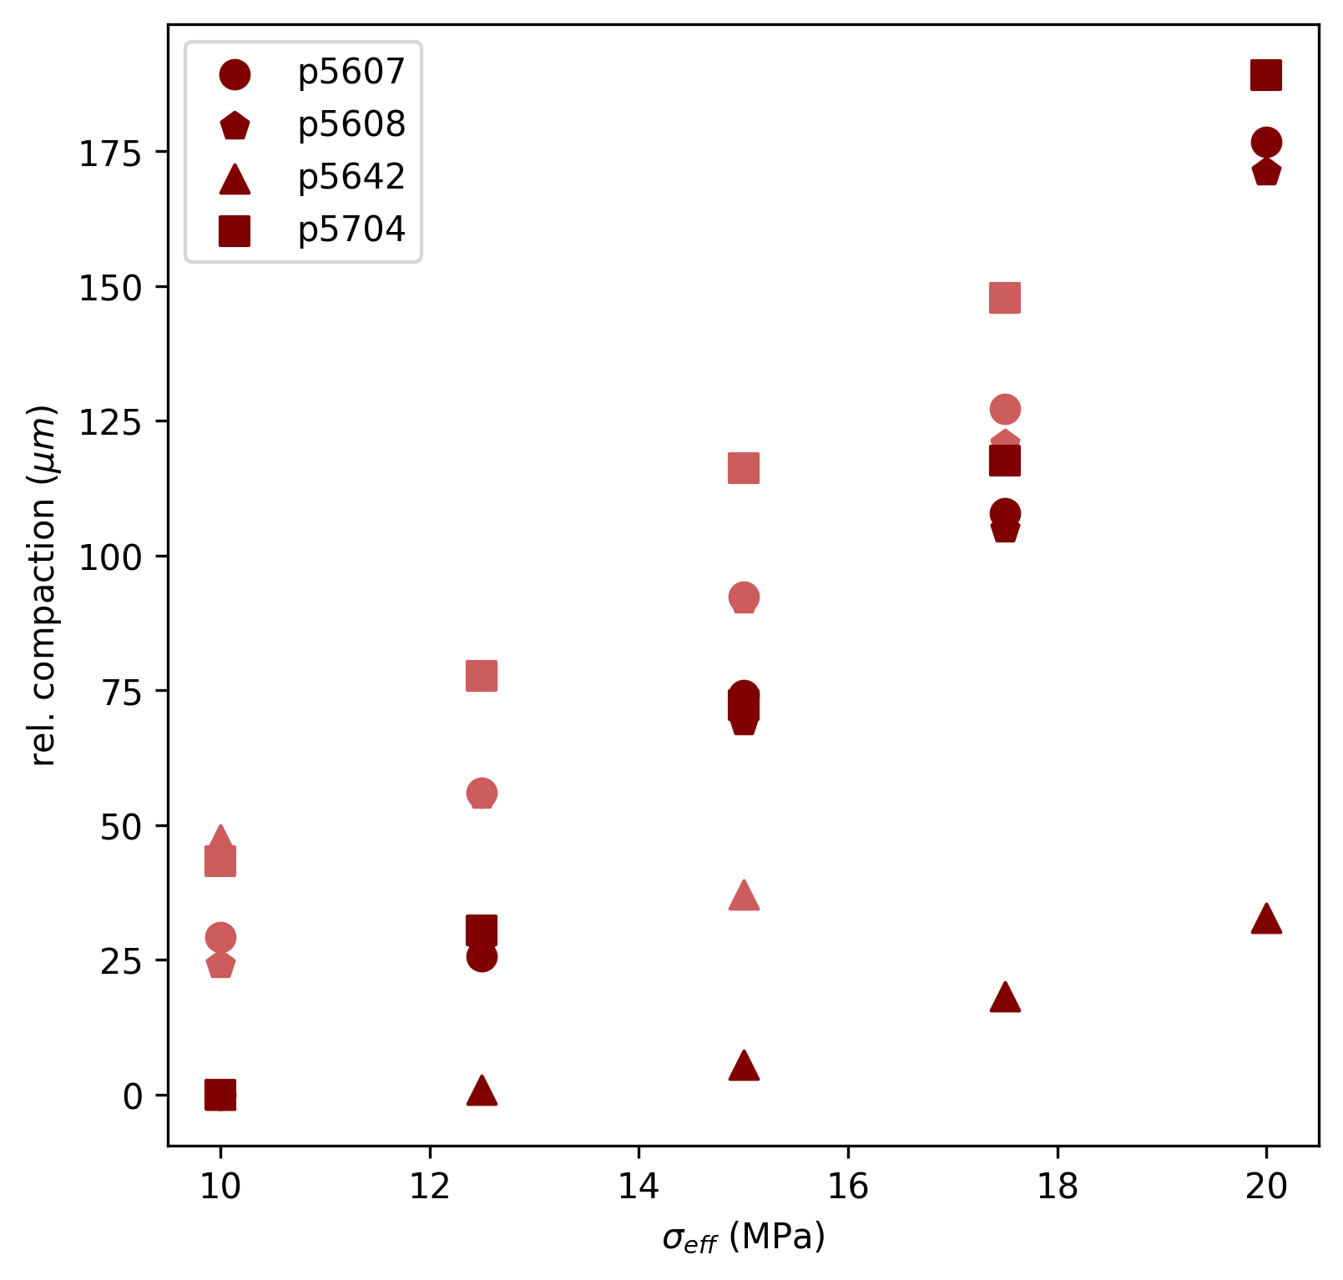
p5607 – 600 grit, NS osc
p5608 – 600 grit, PP osc
p5641 – machine rough, NS osc
p5704 – 80/120 grit, delP

Slide 5
Proposed plan:
Re-roughen w/ same grit
Repeat: 10, 15, 20 flow-thru
Include NS and/or PP oscillations
[0.2, 0.4, 0.6, 0.8, 1.0]Mpa
When?
22 Apr 2022

